Slide 1
Parallel & Distributed Computing (WQD7008)
Faculty of Computer Science and Information Technology
University of Malaya
Program: Master of Data Science
2019/2020 Semester 1
Dr. Hamid Tahaei

Slide 2
Distributed System
A collection of independent entities that cooperate to solve a problem that cannot be individually solved. Distributed systems have been in existence since the start of the universe.
With the widespread proliferation of the Internet and the emerging global village, the notion of distributed computing systems as a useful and widely deployed tool is becoming a reality.
A collection of computers that do not share common memory or a common physical clock, that communicate by messages passing over a communication network, and where each computer has its own memory and runs its own operating system.
Typically the computers are semi-autonomous and are loosely coupled while they cooperate to address a problem collectively.

Slide 3
A collection of independent computers that appears to the users of the system as a single coherent computer.
A term that describes a wide range of computers, from weakly coupled systems such as wide-area networks, to strongly coupled systems such as local area networks, to very strongly coupled systems such as multiprocessor systems.
A distributed system can be characterized as a collection of mostly autonomous processors communicating over a communication network and having the following features:
No common physical clock
No shared memory
Geographical separation
Autonomy and heterogeneity (Independent from each other with different variety)

Slide 4
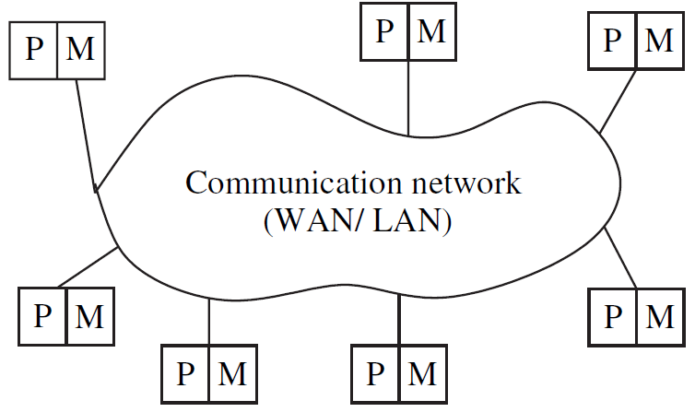

Figure 1. A distributed system connects processors by a communication network.

Slide 5
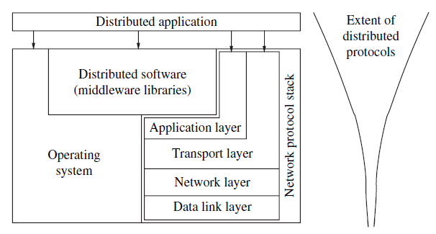
The distributed software is also termed as middleware.
A distributed execution is the execution of processes across the
distributed system to collaboratively achieve a common goal.
An execution is also sometimes termed a computation or a run.
The message-passing interface (MPI) developed in the research community is an example of an interface for various communication functions.
http, mail, ftp, and telnet.
Figure 2. Interaction of the software component of each processor.

Slide 6
Motivation for Distributed Computing
Inherently distributed computations
In many applications such as money transfer in banking, or reaching consensus among parties that are geographically distant, the computation is inherently distributed.
Resource sharing
Resources such as peripherals, complete data sets in databases, special libraries, and etc cannot be fully replicated at all the sites because it is often neither practical nor cost-effective. Further, they cannot be placed at a single site because access to that site might prove to be a bottleneck. Therefore, such resources are typically distributed across the system.

Slide 7
Access to geographically remote data and resources
In many scenarios, the data cannot be replicated at every site participating in the distributed execution because it may be too large or too sensitive to be replicated.
payroll data within a multinational corporation (too large and too sensitive to be replicated at every branch office/site)
therefore stored at a central server which can be queried by branch offices.
special resources such as supercomputers exist only in certain locations, and to access such supercomputers, users need to log in remotely.
Enhanced reliability
Availability.
Integrity.
fault-tolerance.
Increased performance/cost ratio
Scalability
Modularity and incremental expandability
Heterogeneous processors may be easily added into the system without affecting the performance.
Existing processors may be easily replaced by other processors.

Slide 8
Parallel Systems
A parallel system may be broadly classified as belonging to one of three types:
A multiprocessor system is a parallel system in which the multiple processors have direct access to shared memory which forms a common address space.
A multiprocessor system usually corresponds to a uniform memory access (UMA) architecture in which the access latency, i.e., waiting time, to complete an access to any memory location from any processor is the same.
processors are in very close physical proximity and are connected by an interconnection network although the use of message-passing primitives such as those provided by the MPI, is also possible (using emulation on the shared memory).
Inter-process communication across processors is traditionally through read and write operations on the shared memory.
All the processors usually run the same operating system, and both the hardware and software are very tightly coupled.
The processors are usually of the same type.
The interconnection network to access the memory may be a bus-based or switch-based , although for greater efficiency, it is usually a multistage switch with a symmetric and regular design.
Popular interconnection networks: the Omega network, Butterfly network, the Clos Network and the shuffle-exchange networks.

Slide 9
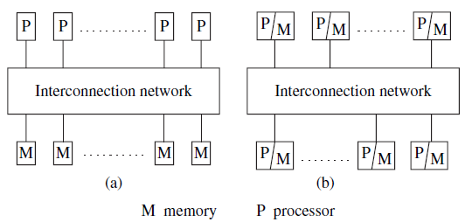
Figure 3 Two standard architectures for parallel systems. (a) Uniform memory access (UMA) multiprocessor system. (b) Non-uniform memory access (NUMA) multiprocessor. In both architectures, the processors may locally cache data from memory.

Slide 10
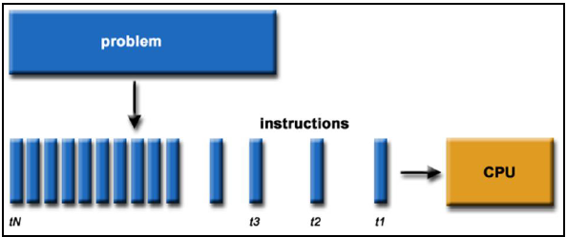
What is Parallel Computing?
Traditionally, software has been written for serial computation:
To be run on a single computer having a single Central Processing Unit (CPU).
A problem is broken into a discrete series of instructions.
Instructions are executed one after another.
Only one instruction may execute at any moment in time.
Figure 4 Parallel Computing

Slide 11
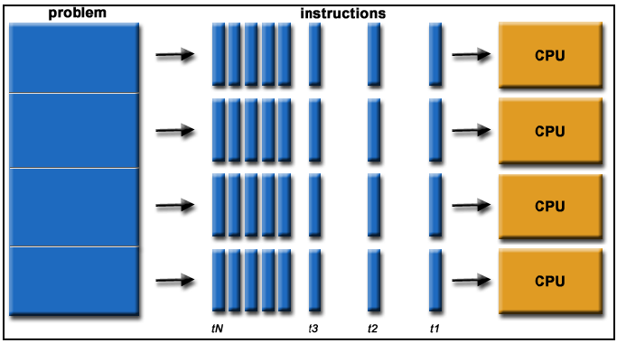
In the simplest sense, parallel computing is the simultaneous use of multiple compute resources to solve a computational problem:
To be run using multiple CPUs
A problem is broken into discrete parts that can be solved concurrently
Each part is further broken down to a series of instructions
Instructions from each part execute simultaneously on different CPUs
Figure 5 Multiple Compute

Slide 12
The compute resources might be:
A single computer with multiple processors;
An arbitrary number of computers connected by a network;
A combination of both.
The computational problem should be able to:
Be broken apart into discrete pieces of work that can be solved simultaneously;
Execute multiple program instructions at any moment in time;
Be solved in less time with multiple compute resources than with a single compute resource.

Slide 13
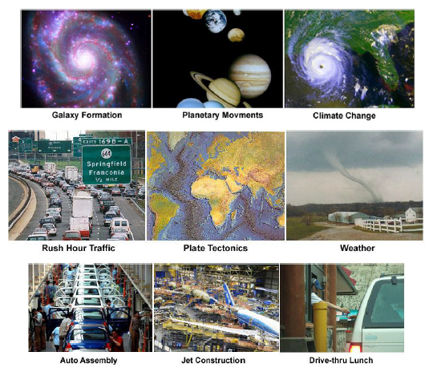
The Universe is Parallel
Figure 6 Every thing Parallel

Slide 14
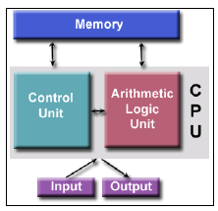
von Neumann Architecture
Named after the Hungarian mathematician John von Neumann who first authored the general requirements for an electronic computer in his 1945 papers.
Since then, virtually all computers have followed this basic design, differing from earlier computers which were programmed through "hard wiring".
Comprised of four main components:
➢ Memory
➢ Control Unit
➢ Arithmetic Logic Unit
➢ Input/output
Control unit fetches instructions/data from memory, decodes the instructions and then sequentially coordinates operations to accomplish the programmed task.
Arithmetic Unit performs basic arithmetic operations
Input/output is the interface to the human operator.
Random access memory is used to store both program instructions and data(Read/write)
➢ Program instructions are coded data which tell the computer to do something.
➢ Data is simply information to be used by the program
Figure 8 von Neumann Model

Slide 15
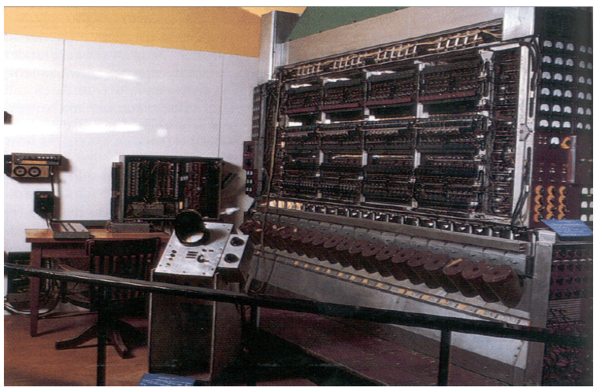
Old von Neumann Computer
Figure 9 von Neumann Machine

Slide 16
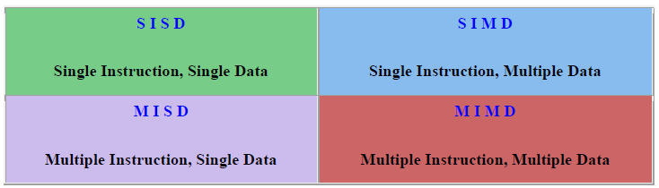
Flynn's Classical Taxonomy
One of the more widely used classifications, in use since 1966, is called Flynn's Taxonomy.
Flynn's taxonomy distinguishes multi-processor computer architectures according to how they can be classified along the two independent dimensions of Instruction and Data. Each of these dimensions can have only one of two possible states: Single or Multiple.
The matrix below defines the 4 possible classifications according to Flynn:
Figure 9 von Neumann Model

Slide 17
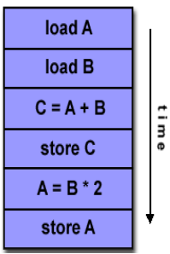
SISD Machines (Single Instruction, Single Data)
A serial (non-parallel) computer
Single Instruction: Only one instruction stream is being acted on by the CPU during any one clock cycle
Single Data: Only one data stream is being used as input during any one clock cycle
Deterministic execution
This is the oldest and even today, the most common type of computer
Examples: older generation mainframes, minicomputers and workstations; most modern day PC’s.
Figure 10 SISD Machines

Slide 18
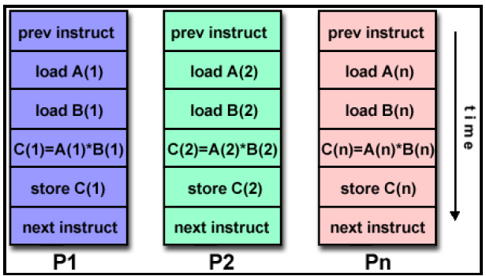
SIMD Machines (Single Instruction, Multiple Data)
Homogenous processors which execute in lock-step on different data items
All processing units execute the same instruction at any given clock cycle.
Multiple Data: Each processing unit can operate on a different data element
Best suited for specialized problems characterized by a high degree of regularity, such as graphics/image processing.
Synchronous (lockstep) and deterministic execution
Two varieties: Processor Arrays and Vector Pipelines
Figure 11 SIMD Machines

Slide 19
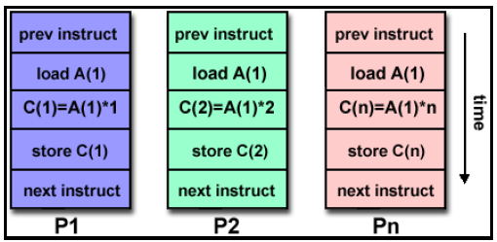
MISD Machines (Multiple Instruction, Single Data)
Multiple Instruction: Each processing unit operates on the data independently via separate instruction streams.
Single Data: A single data stream is fed into multiple processing units.
Few actual examples of this class of parallel computer have ever existed. One is the experimental Carnegie-Mellon C.mmp computer (1971).
Figure 12 MISD Machines

Slide 20
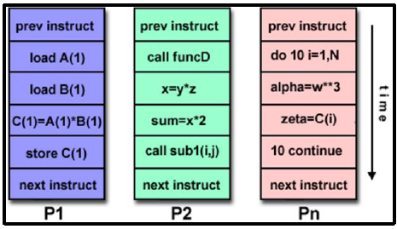
MIMD Machines (Multiple Instruction, Multiple Data)
Multiple Instruction: Every processor may be executing a different instruction stream
Multiple Data: Every processor may be working with a different data stream
Execution can be synchronous or asynchronous, deterministic or non-deterministic.
There is no common clock among the system processors.
Currently, the most common type of parallel computer - most modern supercomputers fall into this category.
Examples: most current supercomputers, networked parallel computer clusters and "grids", multi-processor SMP computers, multi-core PCs.
Note: many MIMD architectures also include SIMD execution sub-components.
Figure 13 MMID Machines

Slide 21
General Parallel Terminology
Supercomputing / High Performance Computing (HPC): Using the world's fastest and largest computers to solve large problems.
Node: A standalone "computer in a box". Usually comprised of multiple CPUs/processors/cores. Nodes are networked together to comprise a supercomputer.
CPU / Socket / Processor / Core: This varies, depending upon who you talk to. In the past, a CPU (Central Processing Unit) was a singular execution component for a computer. Then, multiple CPUs were incorporated into a node. Then, individual CPUs were subdivided into multiple "cores", each being a unique execution unit. CPUs with multiple cores are sometimes called "sockets" - vendor dependent. The result is a node with multiple CPUs, each containing multiple cores. The nomenclature is confused at times.
Task: A logically discrete section of computational work. A task is typically a program or program-like set of instructions that is executed by a processor. A parallel program consists of multiple tasks running on multiple processors.
Pipelining: Breaking a task into steps performed by different processor units, with inputs streaming through, much like an assembly line; a type of parallel computing.

Slide 22
Shared Memory: From a strictly hardware point of view, describes a computer architecture where all processors have direct (usually bus based) access to common physical memory. In a programming sense, it describes a model where parallel tasks all have the same "picture" of memory and can directly address and access the same logical memory locations regardless of where the physical memory actually exists.
Symmetric Multi-Processor (SMP): Hardware architecture where multiple processors share a single address space and access to all resources; shared memory computing.
Distributed Memory: In hardware, refers to network based memory access for physical memory that is not common. As a programming model, tasks can only logically "see" local machine memory and must use communications to access memory on other machines where other tasks are executing.
Communications: Parallel tasks typically need to exchange data. There are several ways this can be accomplished, such as through a shared memory bus or over a network, however the actual event of data exchange is commonly referred to as communications regardless of the method employed.
Synchronization: The coordination of parallel tasks in real time, very often associated with communications. Often implemented by establishing a synchronization point within an application where a task may not proceed further until another task(s) reaches the same or logically equivalent point. Synchronization usually involves waiting by at least one task, and can therefore cause a parallel application's wall clock execution time to increase.

Slide 23
Granularity: In parallel computing, granularity is a qualitative measure of the ratio of computation to communication.
Coarse: Relatively large amounts of computational work are done between communication events
Fine: Relatively small amounts of computational work are done between communication events
Observed Speedup: Observed speedup of a code which has been parallelized, defined as:
wall-clock time of serial execution
wall-clock time of parallel execution
One of the simplest and most widely used indicators for a parallel program's performance.
Parallel Overhead: The amount of time required to coordinate parallel tasks, as opposed to doing useful work. Parallel overhead can include factors such as:
Task start-up time
Synchronizations
Data communications
Software overhead imposed by parallel compilers, libraries, tools, operating system, etc.
Task termination time

Slide 24
Massively Parallel: Refers to the hardware that comprises a given parallel system - having many processors. The meaning of "many" keeps increasing, but currently, the largest parallel computers can be comprised of processors numbering in the hundreds of thousands.
Embarrassingly Parallel: Solving many similar, but independent tasks simultaneously; little to no need for coordination between the tasks.
Scalability: Refers to a parallel system's (hardware and/or software) ability to demonstrate a proportionate increase in parallel speedup with the addition of more processors. Factors that contribute
Hardware - particularly memory-cpu bandwidths and network communications.
Application algorithm.
Parallel overhead related.

Slide 25
Performance attributes
Performance of a system depends upon
i. Hardware technology, ii. Architectural features, iii. Efficient resource management, iv. Algorithm design, v. Data structures, vi. Language efficiency, vii. Programmer skill, viii. Compiler technology
Performance of computer system we would describe how quickly a given system can execute a program or programs. Thus we are interested in knowing the turnaround time. Turnaround time depends on:
i. Disk and memory accesses, ii. Input and out put, iii. Compilation time, iv. Operating system overhead, v. Cpu time
An ideal performance of a computer system means a perfect match between the machine capability and program behavior.
The machine capability can be improved by using better hardware technology and efficient resource management.

Slide 26
But as far as program behavior is concerned it depends on code used, compiler used and other run time conditions. Also a machine performance may vary from program to program.
Because there are too many programs and it is impractical to test a CPU's speed on all of them, benchmarks were developed. Computer architects have come up with a variety of metrics to describe the computer performance.
Clock rate and CPI / IPC
MIPS:
MFLOPS (“megaflops”')
Throughput rate
Speed or Throughput (W/Tn)
Speedup (Sn = T1/Tn)
Efficiency (En = Sn/n)
Degree of Parallelism (DOP)
Scalability

Slide 27
Applications of distributed computing and newer challenges
Mobile systems
Sensor networks
Ubiquitous or pervasive computing
Peer-to-peer computing
Publish-subscribe, content distribution, and multimedia
Distributed agents
Distributed data mining
Grid computing
Security in distributed systems

Slide 28
Cloud Computing
Cloud Computing is a style of computing in which dynamically scalable and often virtualized resources are provided over the Internet.
Users need not have knowledge of, expertise in, or control over the technology infrastructure in the “cloud” that support them.
Compared to: Grid Computing (cluster of networked, loosely coupled computers).
Utility Computing (packaging of computing resources as a metered service). It is a service provisioning model in which a service provider makes computing resources and infrastructure management available to the customer as needed, and charges them for specific usage rather than a flat rate.
Autonomic Computing (computer systems capable of self-management). It Refers to the self-managing characteristics of distributed computing resources.

Slide 29
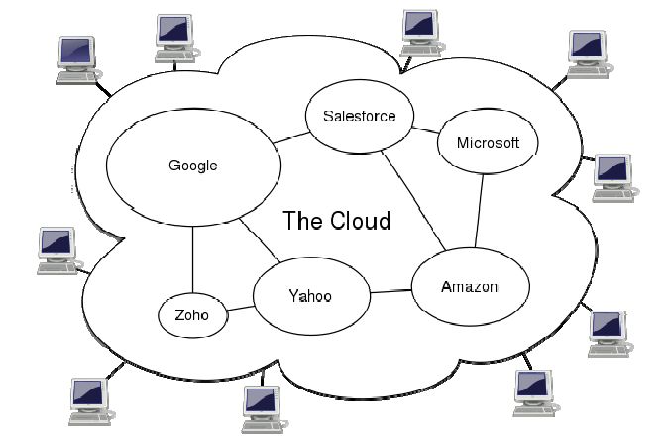
Cloud Computing
Figure 14 Cloud Computing schema

Slide 30
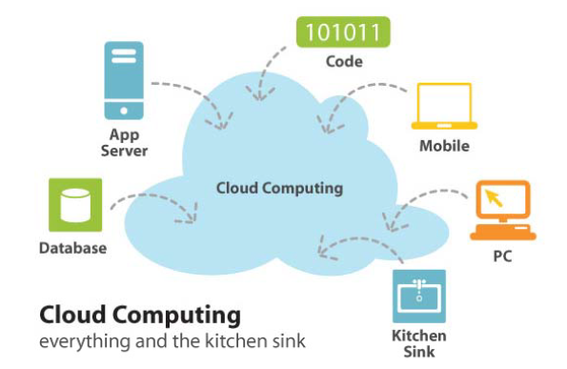
Cloud Computing
A means to increase computing capacity or add computing capabilities at any time
without investing in new infrastructure, training new personnel, or licensing new
software
Figure 15 Cloud Computing view

Slide 31
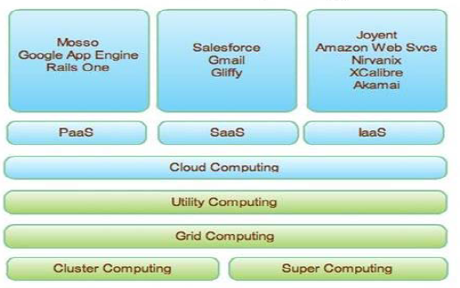
Cloud Computing
Distribution models and services.
Figure 16 Cloud Computing underlying view

Slide 32
Assignment
What are the differences between a parallel system and a distributed system? (How parallel and distributed computing is distinguished).
Reference:
Dongarra, J and Hwang, K., Distributed and Cloud Computing: From Parallel Processing to the Internet of Things, 1st Edition, Morgan Kaufmann, 2013.
Colouries, G., Dollimore, J., Kindberg, T and Blair, G., Distributed Systems: Concepts and Design, 5th Edition, Addison-Wesley, 2012.
Tanenbaum A.S. and van Steen M., Distributed Systems: Principles and Paradigms, 2nd Edition, Prentice Hall, 2007.
Lin, C. and Snyder, L., Principles of Parallel Programming, 1st Edition, Addison-Wesley, 2009.
Michel Raynal: "Parallel Computing vs. Distributed Computing: A Great Confusion?", Proc. Euro-Par 2015, doi:10.1007/978-3-319-27308-2_4

